Slide 1
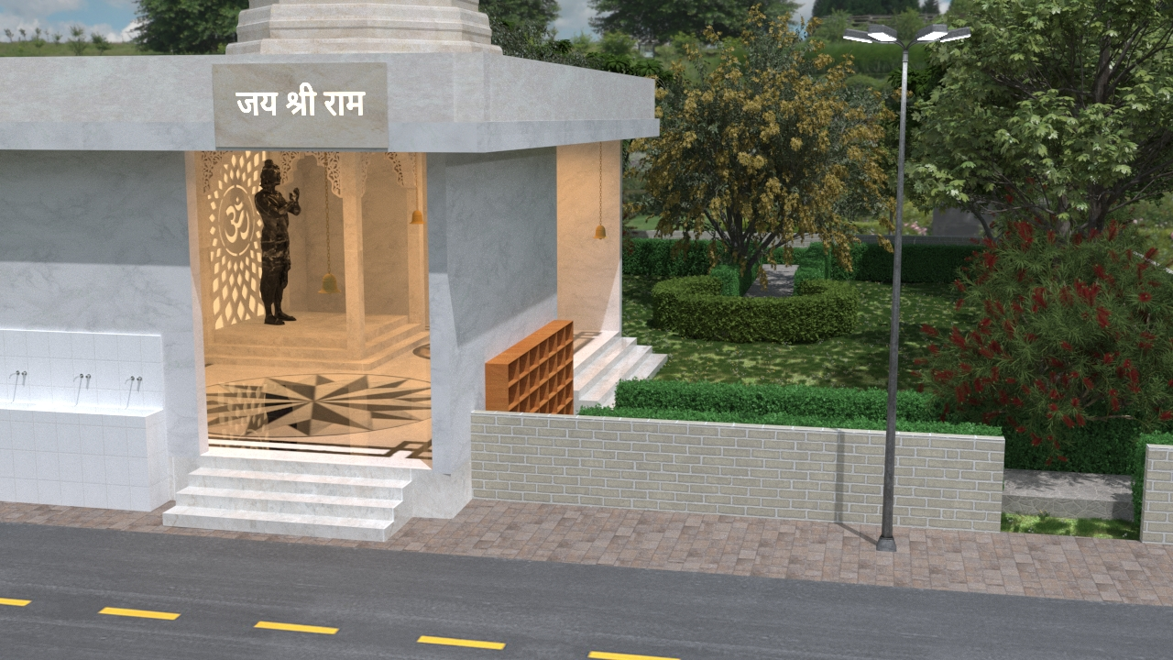
Ram mandir

Slide 2
Located in ganga nagar , meerut
Ram mandir

Slide 3
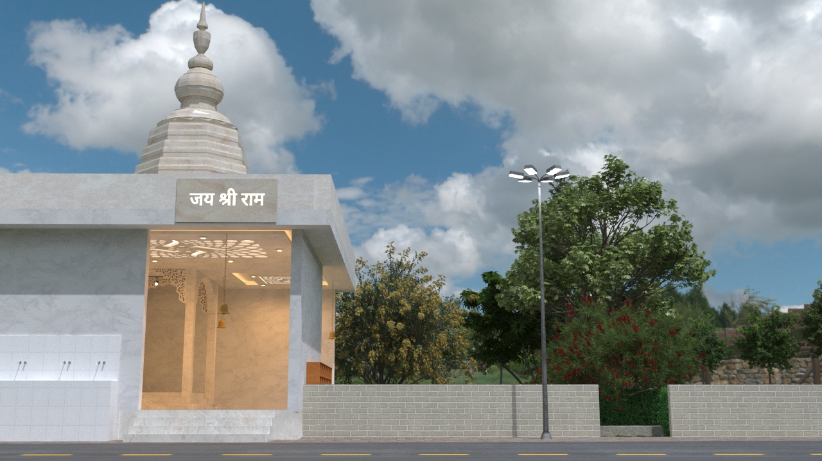
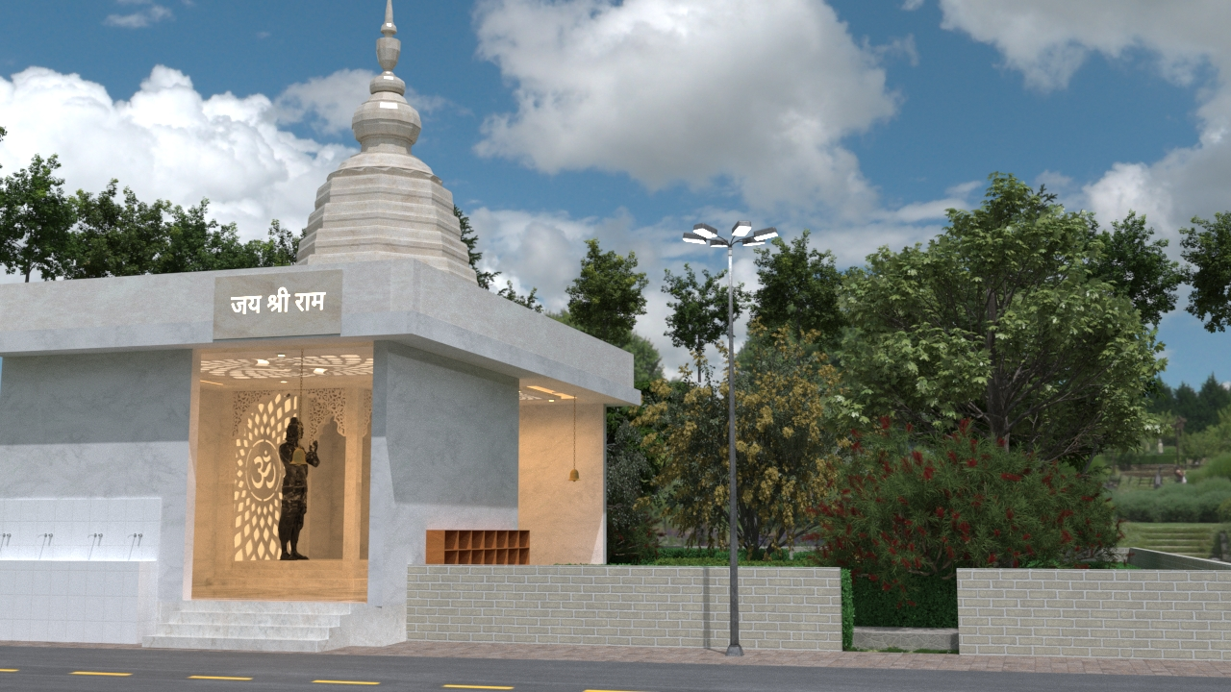
Located in ganga nagar , meerut
Ram mandir

Slide 4
Located in ganga nagar , meerut
Ram mandir

Slide 5
Ram mandir

Slide 6
Located in ganga nagar , meerut
Ram mandir

Slide 7
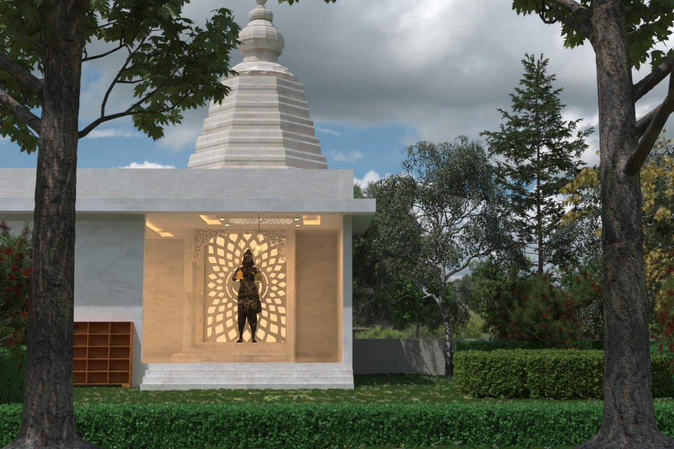
Ram mandir

Slide 8
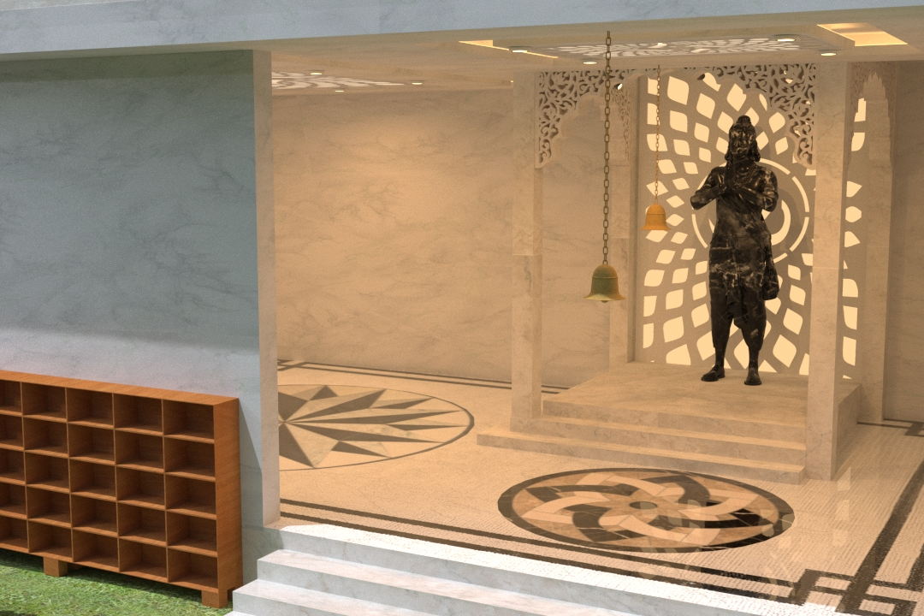
Ram mandir

Slide 9
Ram mandir

Slide 10
Ram mandir

Slide 11
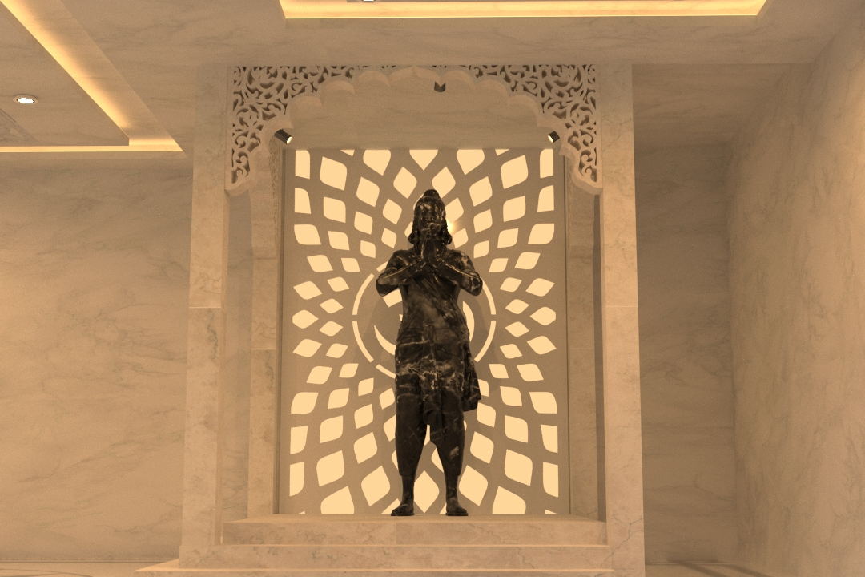
Ram mandir

Slide 12
Ram mandir

Slide 13
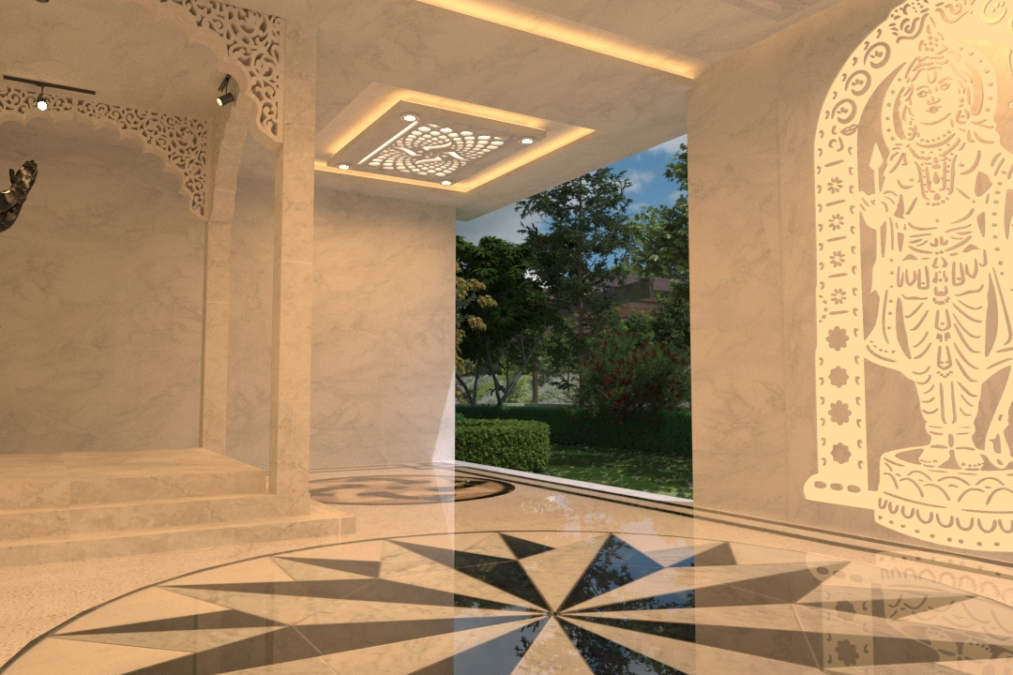
Ram mandir

Slide 14
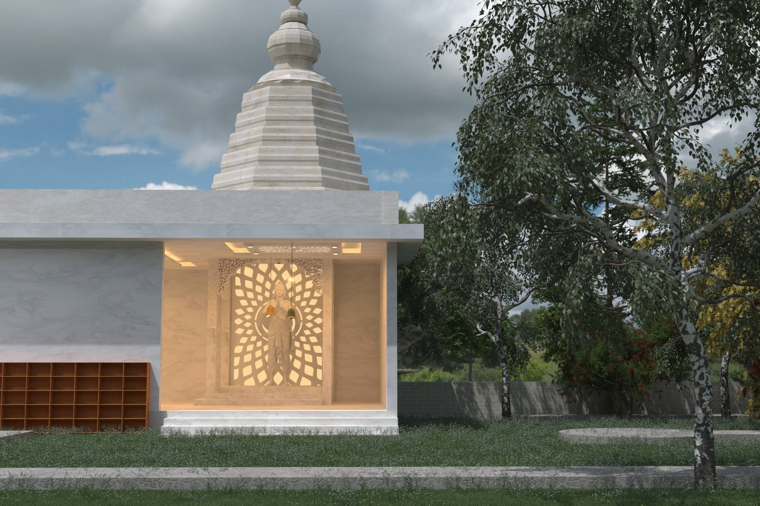
Ram mandir

Slide 15
Ram mandir

Slide 16
Ram mandir

Slide 17
Ram mandir
9’7”

Slide 18
Ram mandir
9’7”

Slide 19
Ram mandir

Slide 20
9’7”
Ram mandir

Slide 21
Ram mandir

Slide 22
9’7”
Ram mandir

Slide 23
Ram mandir
Thanks for watching

Slide 24
RAM RAM
Ram mandir
Thanks for watching

Slide 25
Ram mandir
Thanks for watching

Slide 26
Ram mandir
RAM RAM
Thanks for watching

